Slide 1
Platforms to Run the Code on
Locally using a Virtual Box Linux system
Google Cloud Platform (Compute Engine - Dataproc)
Databricks.com

Slide 2

What is Big Data?

Slide 3
What is Big Data?
Big data is the term for a collection of data sets so large and complex that it becomes difficult or impossible to process using conventional databases or traditional data processing techniques.
The challenges include acquisition, organization, storage, search, sharing, transfer, analysis, and visualization.
Any data that exceeds our current capability of processing can be regarded as “big”.

Slide 4
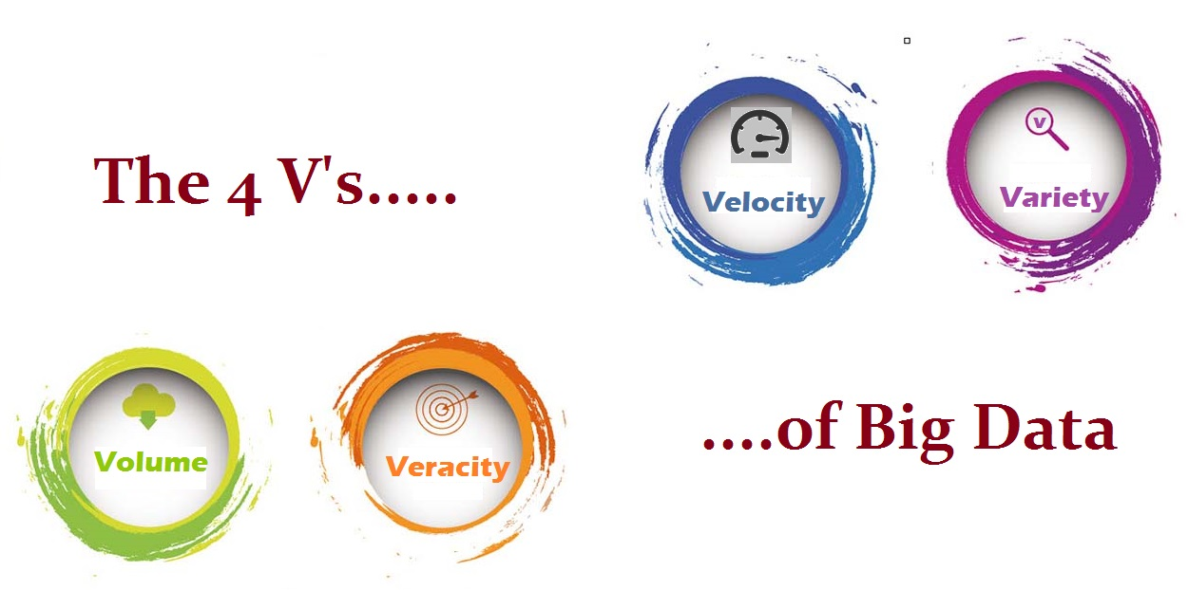
Big Data - 4 V’s

Slide 5
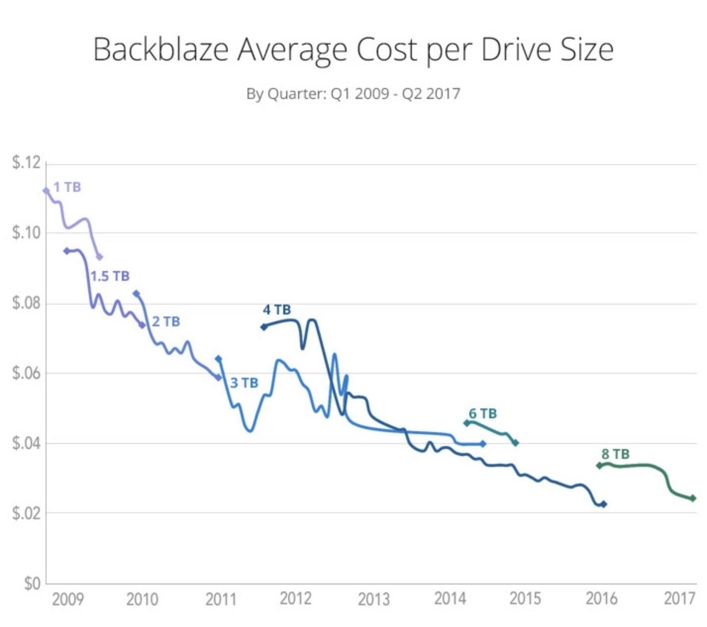
Volume: scale of data
40 zettabytes (4o billion TBs) of data has been created (by 2020), an increase of 300 times from 2005, and the equivalent of 5 TBs of data for every man, woman and child on earth.
This charts shows the cost of hard drives per GB according to Backblaze, a storage solution company, from 2009 to 2017.
Hard drive prices have dropped, from around $500k per gigabyte in 1981 (not shown) to less than $0.03 per gigabyte in 2017.

Slide 6
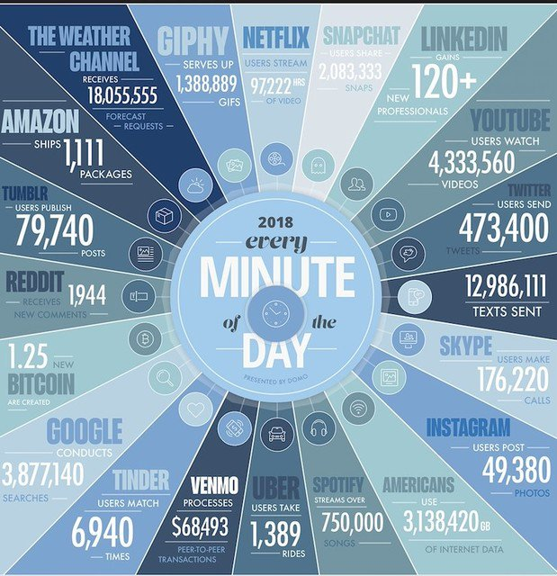
Velocity: processing streaming data
Data is being generated fast and needs to be processed fast.
Let’s use Youtube as an example:
Over 1 billion users
400+ hours of videos are uploaded every minute
That’s ~10,000 TBs of content added every day

Slide 7
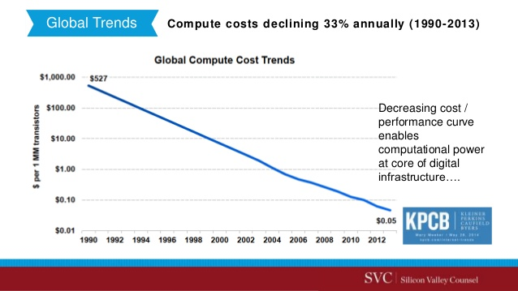
Velocity: processing streaming data
Data is being generated fast and needs to be processed fast
Social media
Sensor data
Mobile devices
Scientific instruments
Fast processing requires fast computers, and a lot of them. Thanks to significant drop in compute cost in the recent decades that have made this possible.

Slide 8

Variety: different forms of data
Data comes in all forms:
Relational Data (Tables/Transaction)
Semi-structured Data (XML)
Unstructured data (HTML, Images, text, voice)
Most of available data is unstructured.

Slide 9
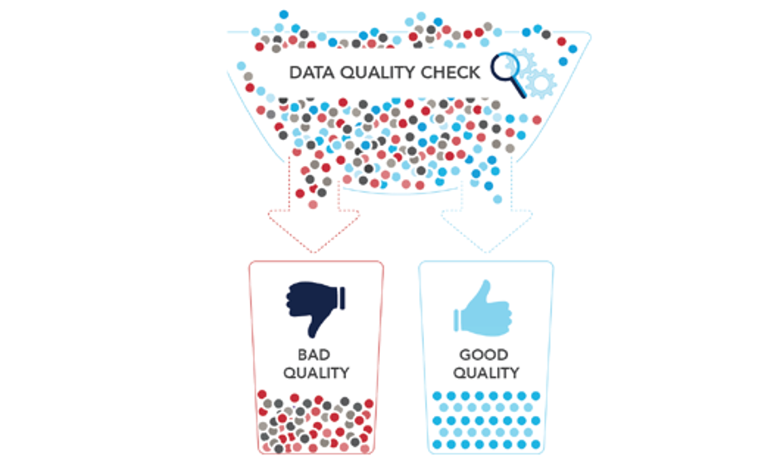
Veracity: reliability of data
Data in doubt!
Data quality check is a part of data cleaning that needs to be done before any serious analysis:
Origin
Authenticity
Trustworthiness
Completeness
Integrity

Slide 10
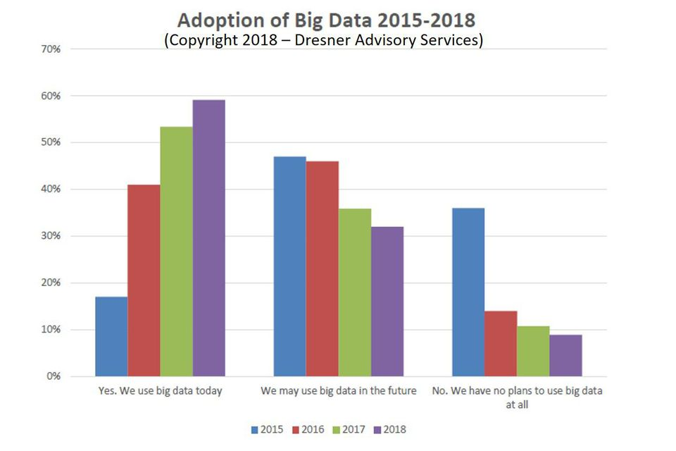
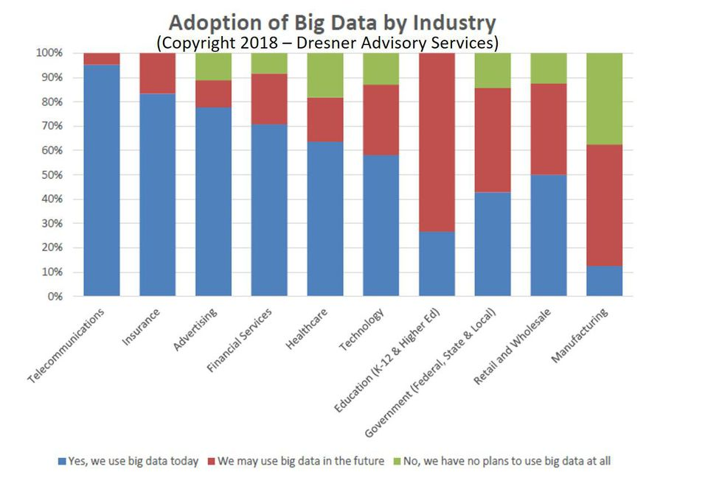
Big Data Adoption
Across Industries
Big data adoption in enterprises soared from 17% in 2015 to 59% in 2018, reaching a Compound Annual Growth Rate (CAGR) of 36% according to the study. (Forbes)
Data Warehouse Optimization, Forecasting and Customer/Social Analysis are the three most critical big data analytics use cases in enterprises today. (Forbes)
DRESNER ADVISORY SERVICES - 2018

Slide 11
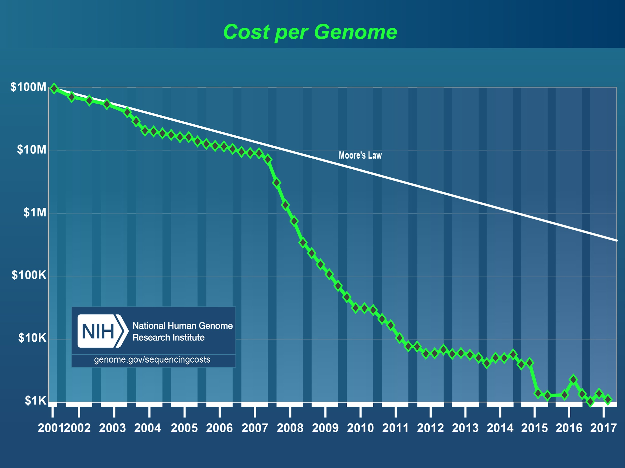
Faster and Cheaper Technology - Processing
This cost decrease is due to significant improvements in technology and data storage systems.

Slide 12
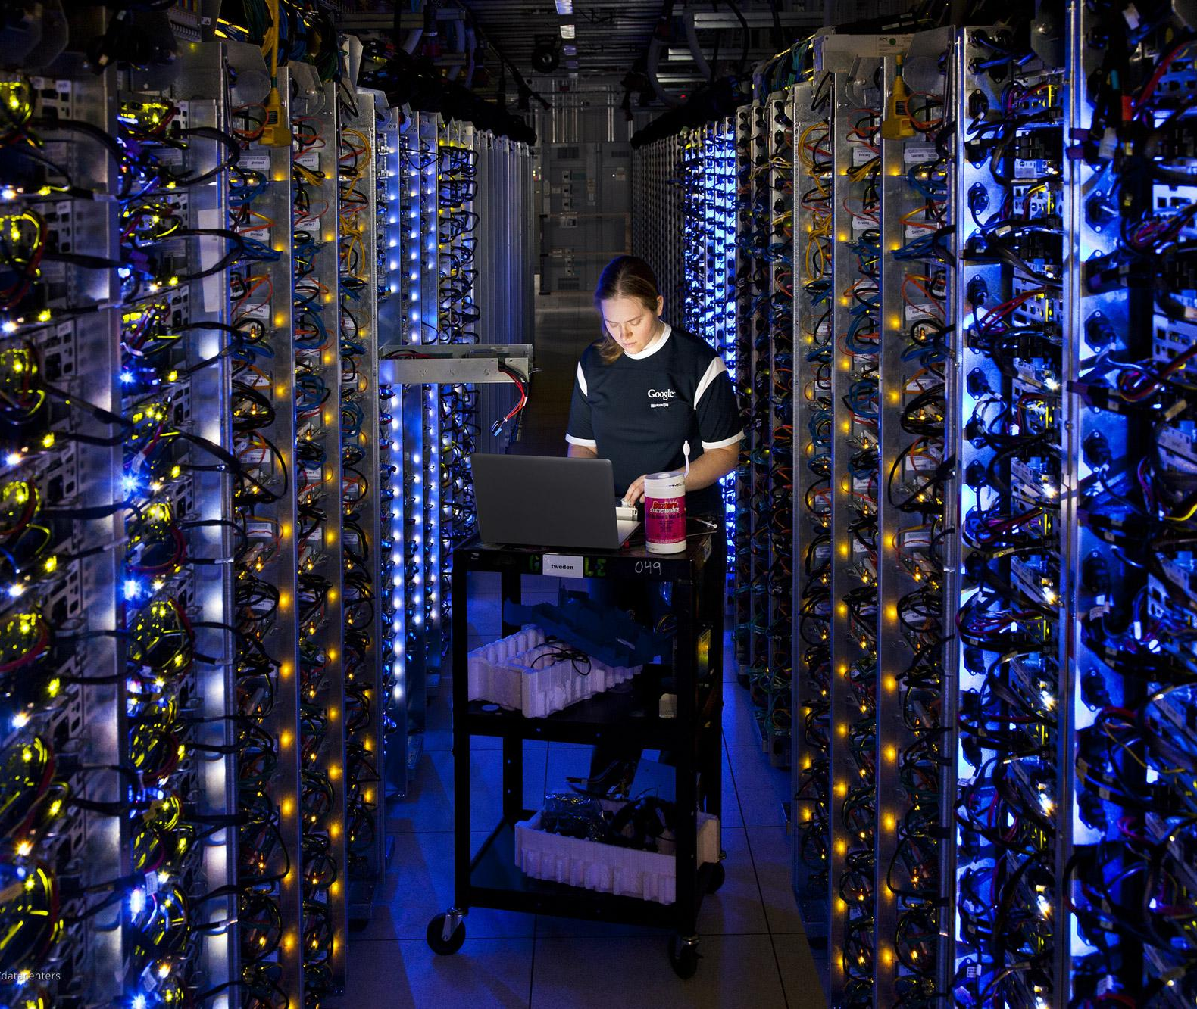
Cloud Computing

Slide 13
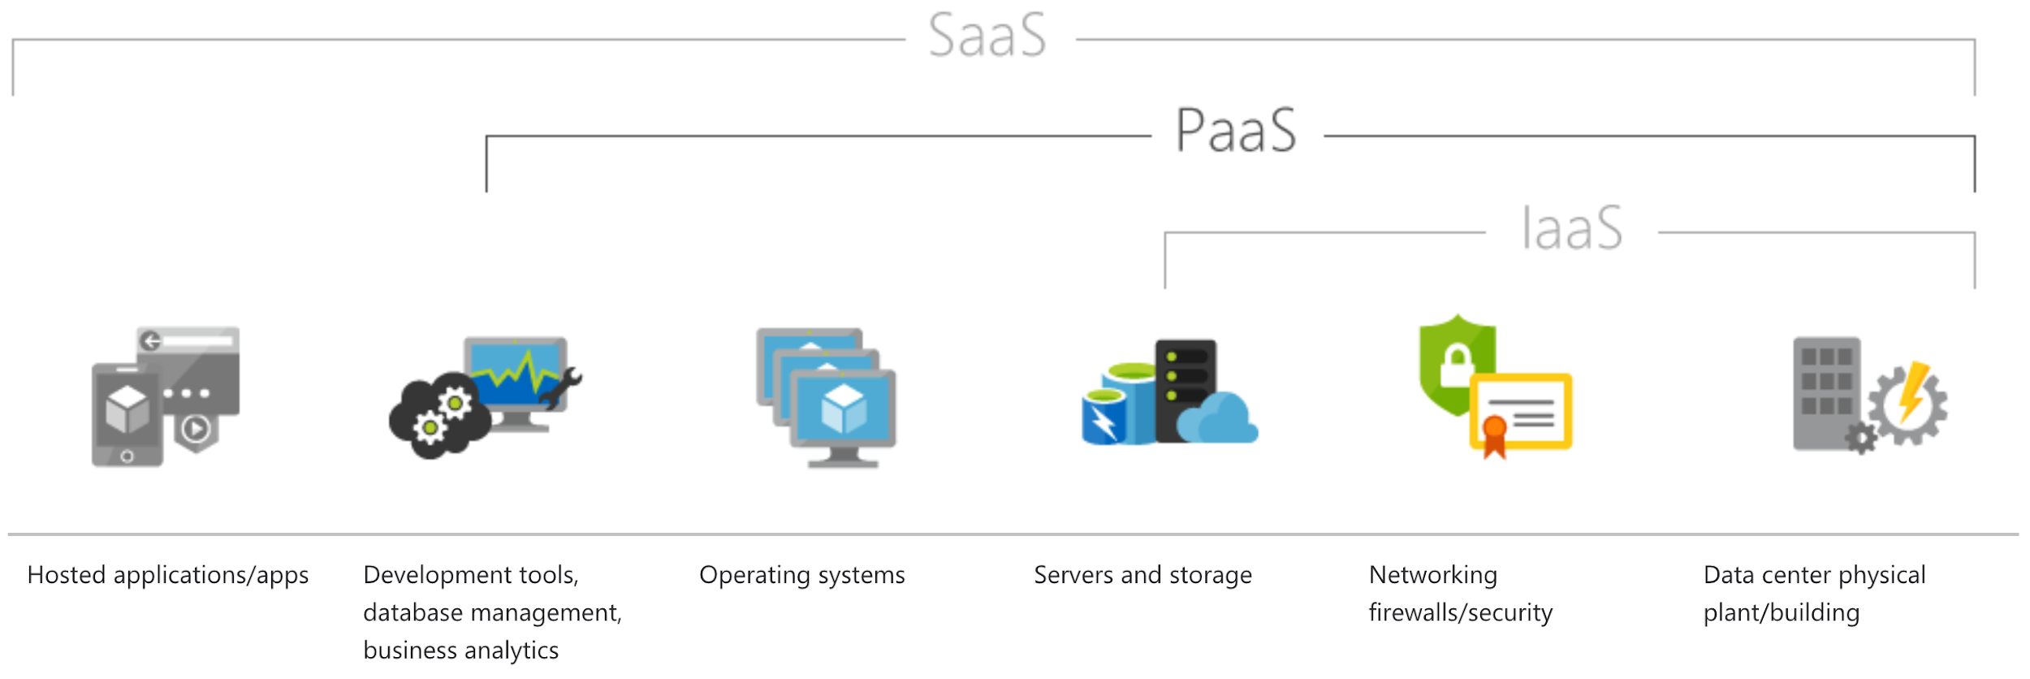
Cloud Computing - Service Models
Infrastructure as a service (IaaS)
Hardware related services
Google Compute Engine
Amazon EC2
Windows Azure
Platform as a Service (PaaS)
Development platform on cloud
Google’s App Engine, Salesforce.com
Google collab
Software as a service (SaaS)
Offering a complete software on cloud
Gmail, Microsoft Office 365
Serverless computing
Database as a service: Google BigQuery
Function as a service (FaaS)

Slide 14





Popular Cloud Platforms
Amazon Web Services - AWS
Microsoft Azure
Google Cloud Platform - GCP
IBM Cloud
Alibaba Cloud

Slide 15
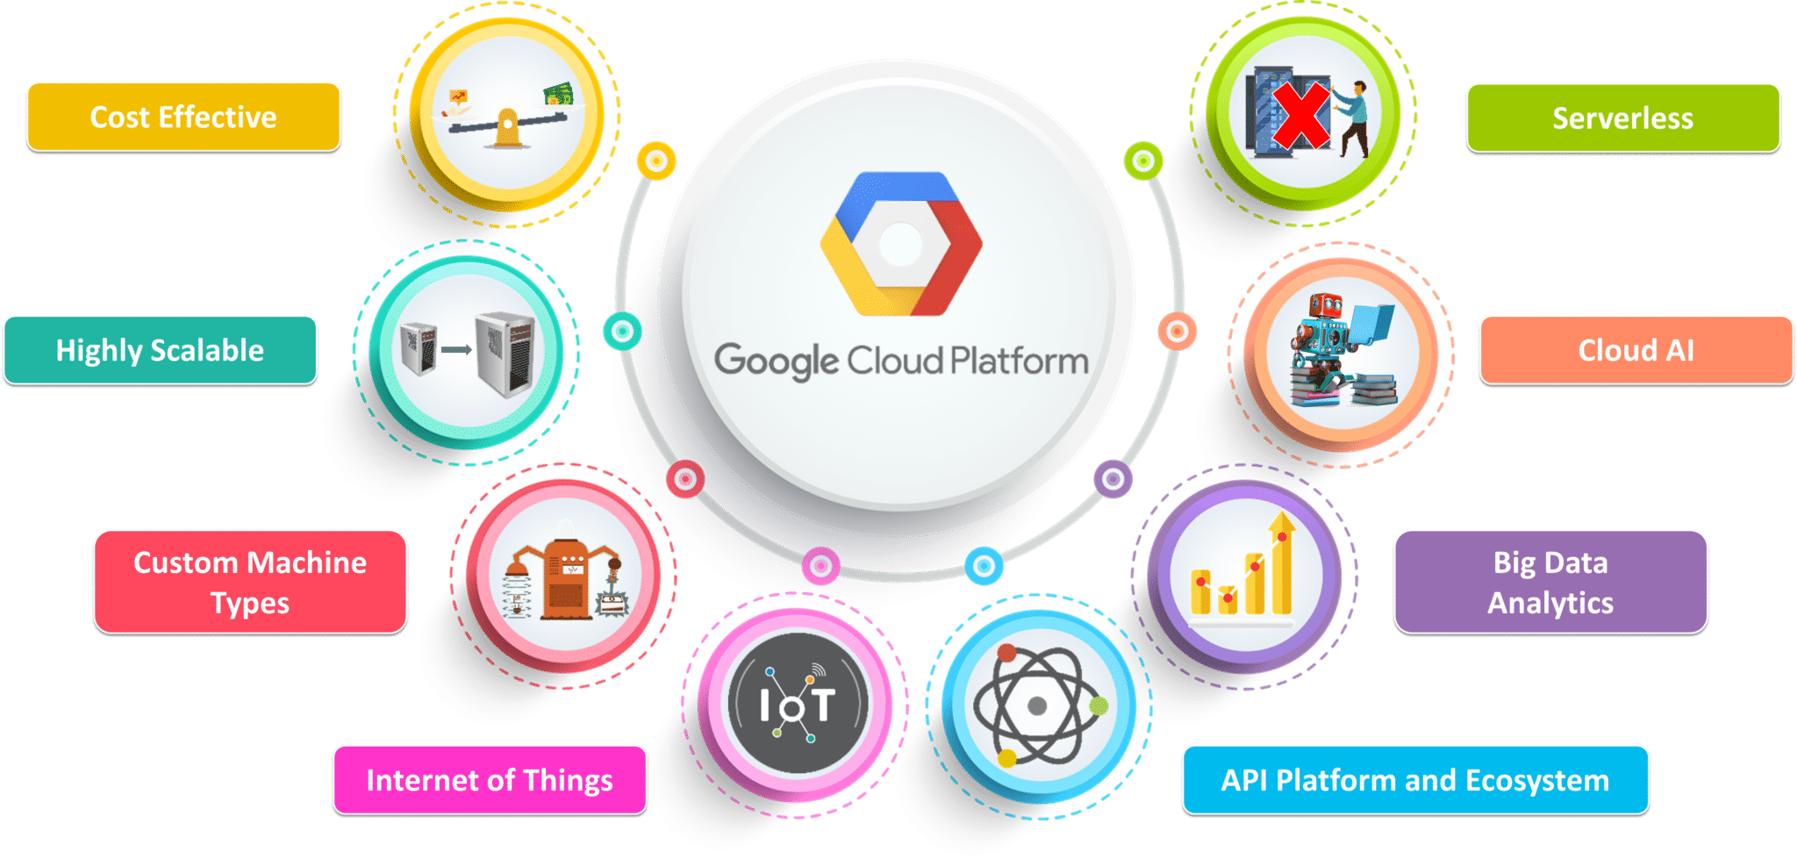
Why Cloud?

Slide 16
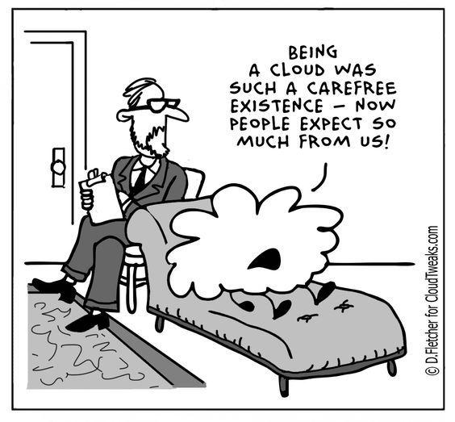
What Cloud Services Are Available?

Slide 17
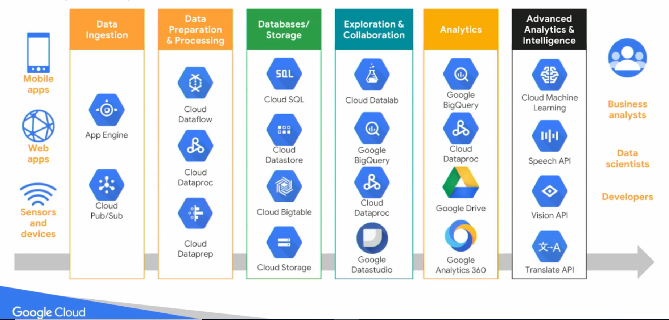
Google Cloud Platform - Services

Slide 18
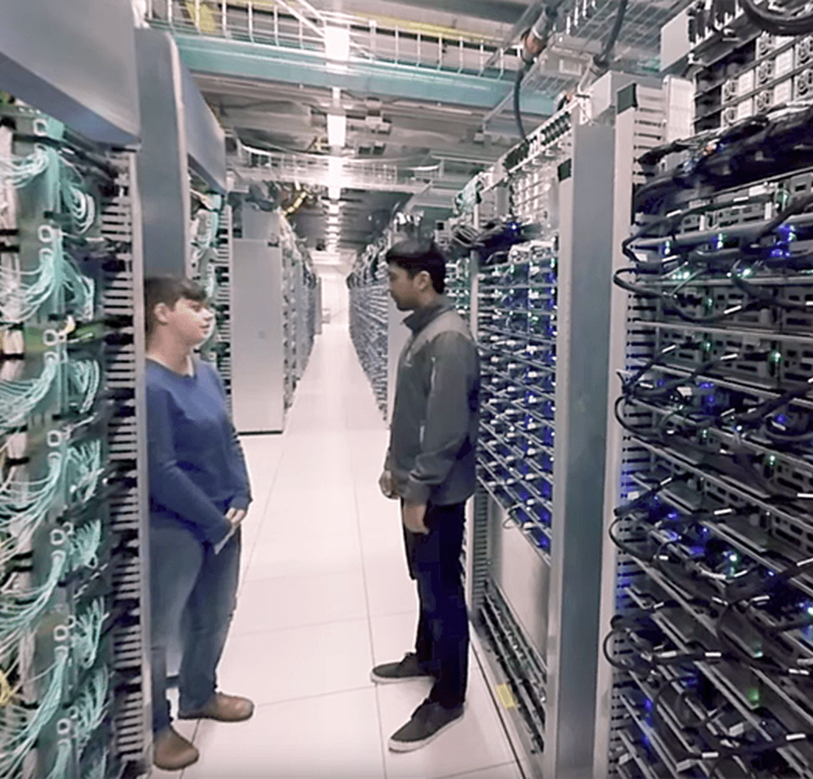
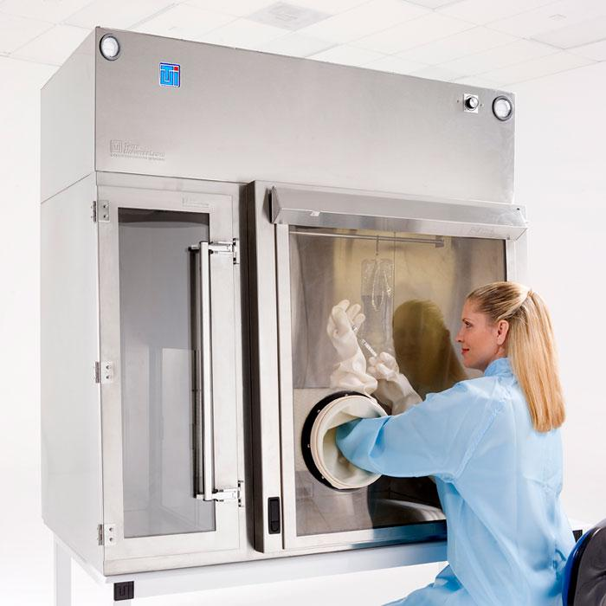
Leave Your Data in the Cloud

Slide 19

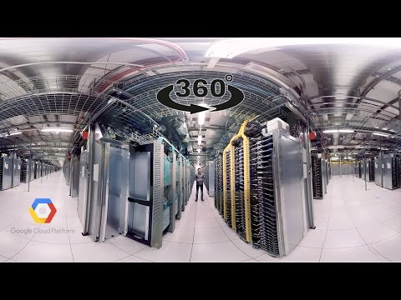
Google Data Center

Slide 20
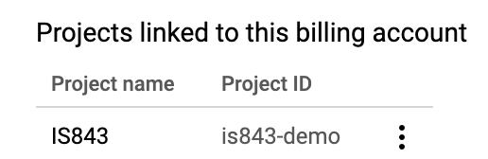
Coupon and Project Setup
Please follow the link on Slack to get your $50 coupon. Make sure to sign up with you BU email address and NOT your personal Gmail account.
Login: https://console.cloud.google.com
Set up a project
Give the project a name; something like IS843
From Google Cloud Platform menu go to Billing > Go to linked billing account > Account Management. Make sure that you see your project name under the coupon
Please DO NOT provide your credit card information for the purpose of this course!

Slide 21
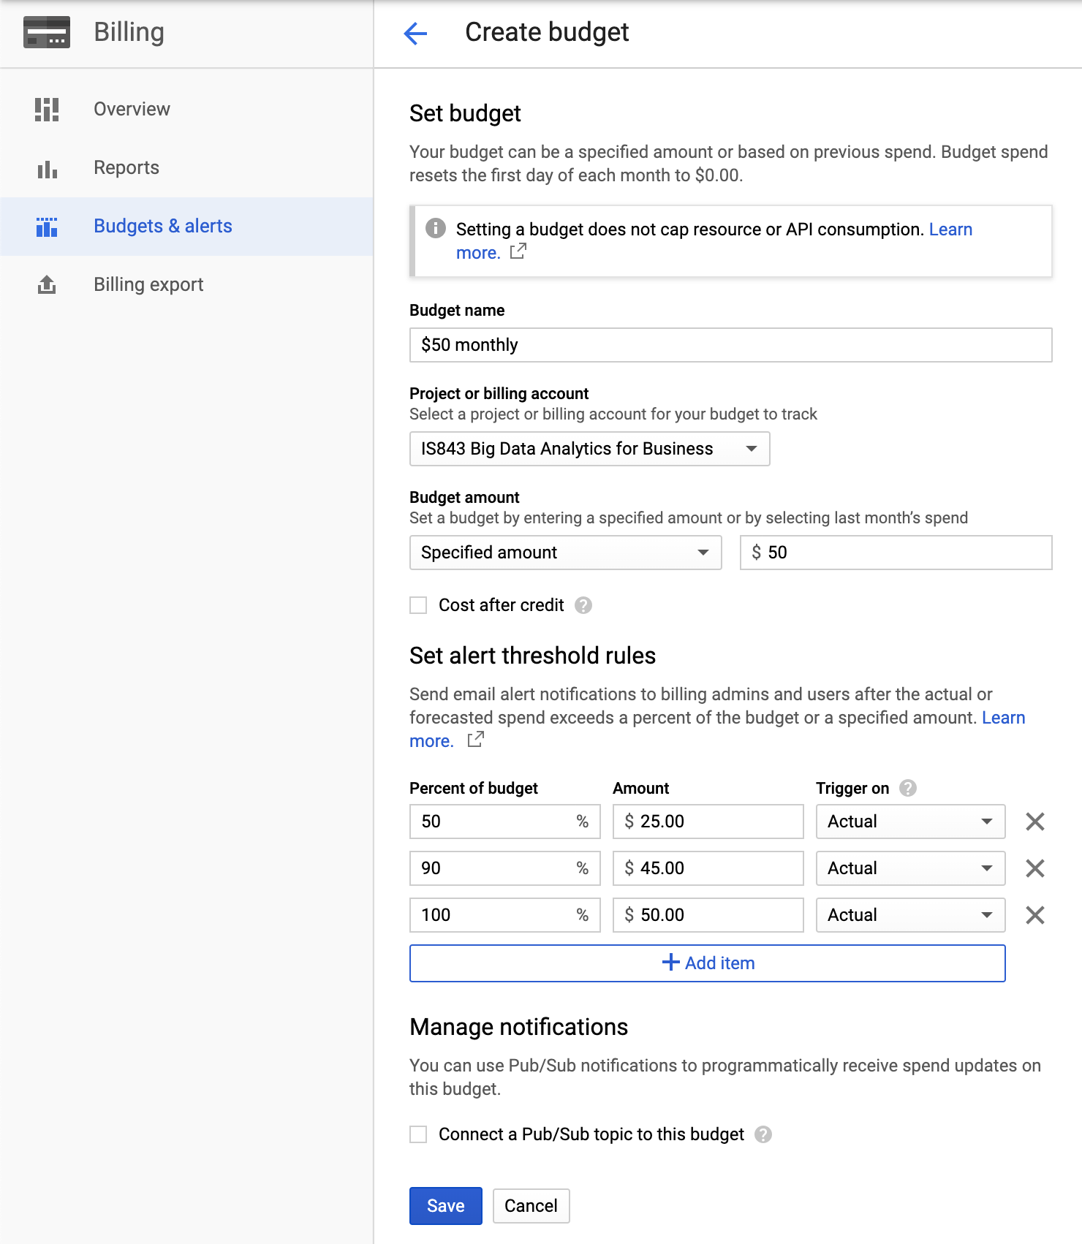
Budgets and Alerts
Go to Billing > Go to linked billing account > Budgets and alerts > Create a budget
Set the followings:
Budget name
Budget amount (E.g. $10/month)
Uncheck discount and promotions
Percent of budget to receive notifications

Slide 22
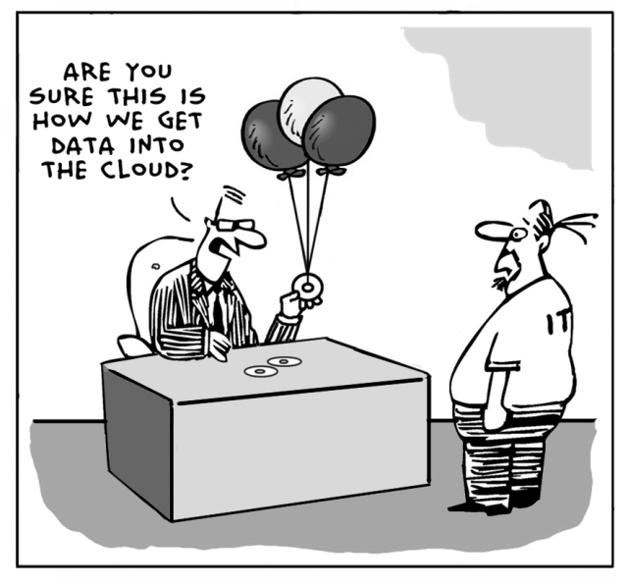
Getting Data Into the Cloud…
Photo credit

Slide 23

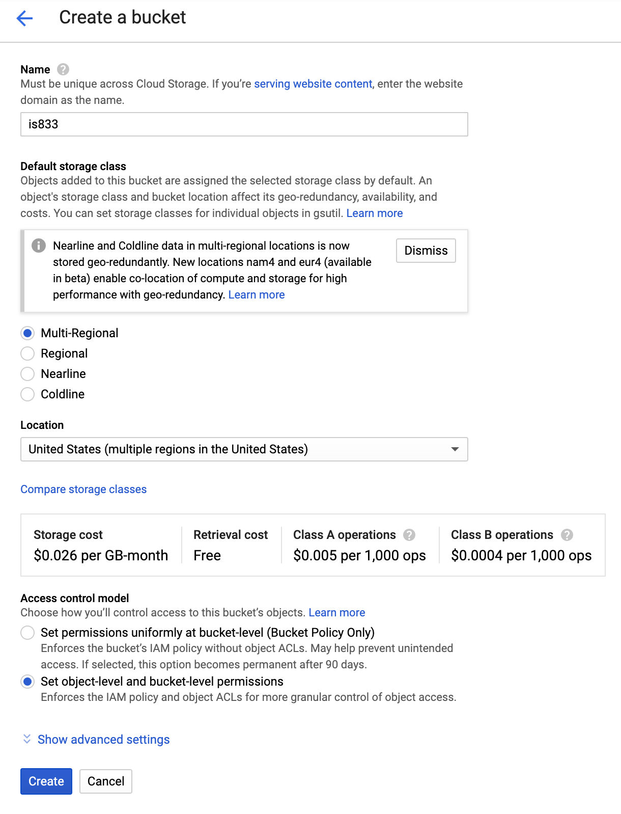
Create Cloud Storage Bucket
Go to STORAGE > Storage > CREATE BUCKET
Give it a name; for instance is843-xx, where xx are your initials.
Note: Bucket names are universally unique.

Slide 24
Cloud Storage - Upload Files
Cloud storage buckets through the UI work very similar to a Dropbox folder.
Upload data/Telco-Customer-Churn.csv to the bucket you just created.
NOTE: Everyone in your project has visibility to your bucket, avoid uploading sensitive and private information.

Slide 25
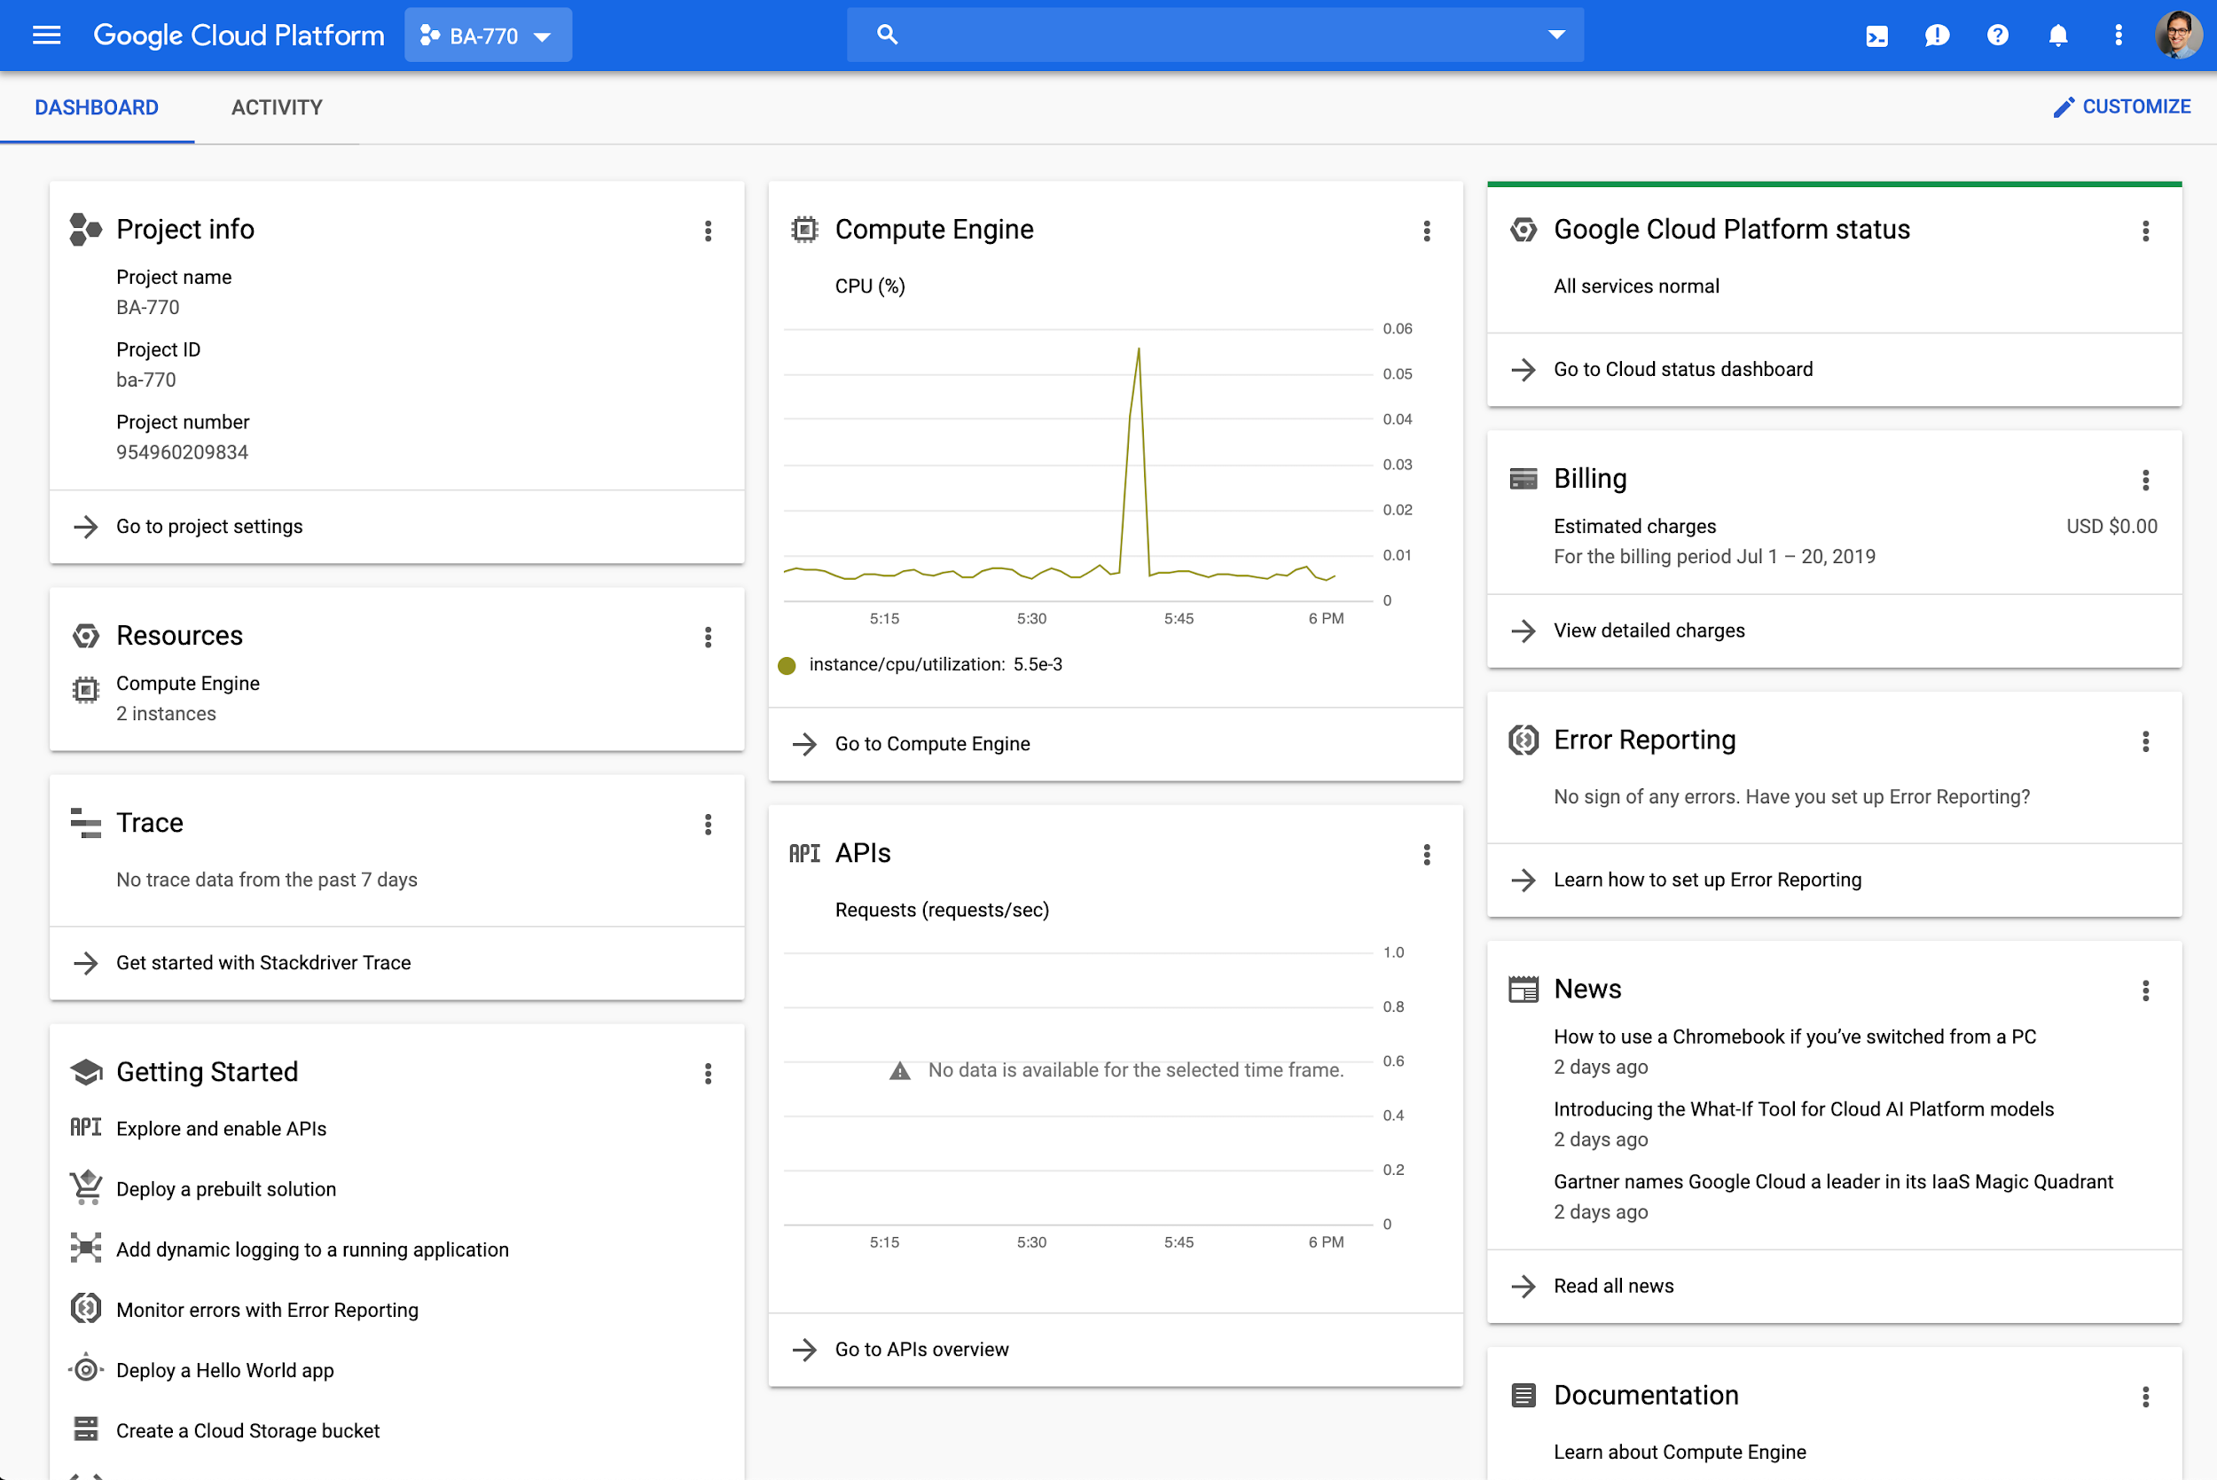
Google Cloud Platform Console
This is the web console and central development hub for GCP.
http://console.cloud.google.com will take you to GCP console. Everytime you land on a GCP new page make sure that are using your BU account as it could have unintended consequences!

Slide 26
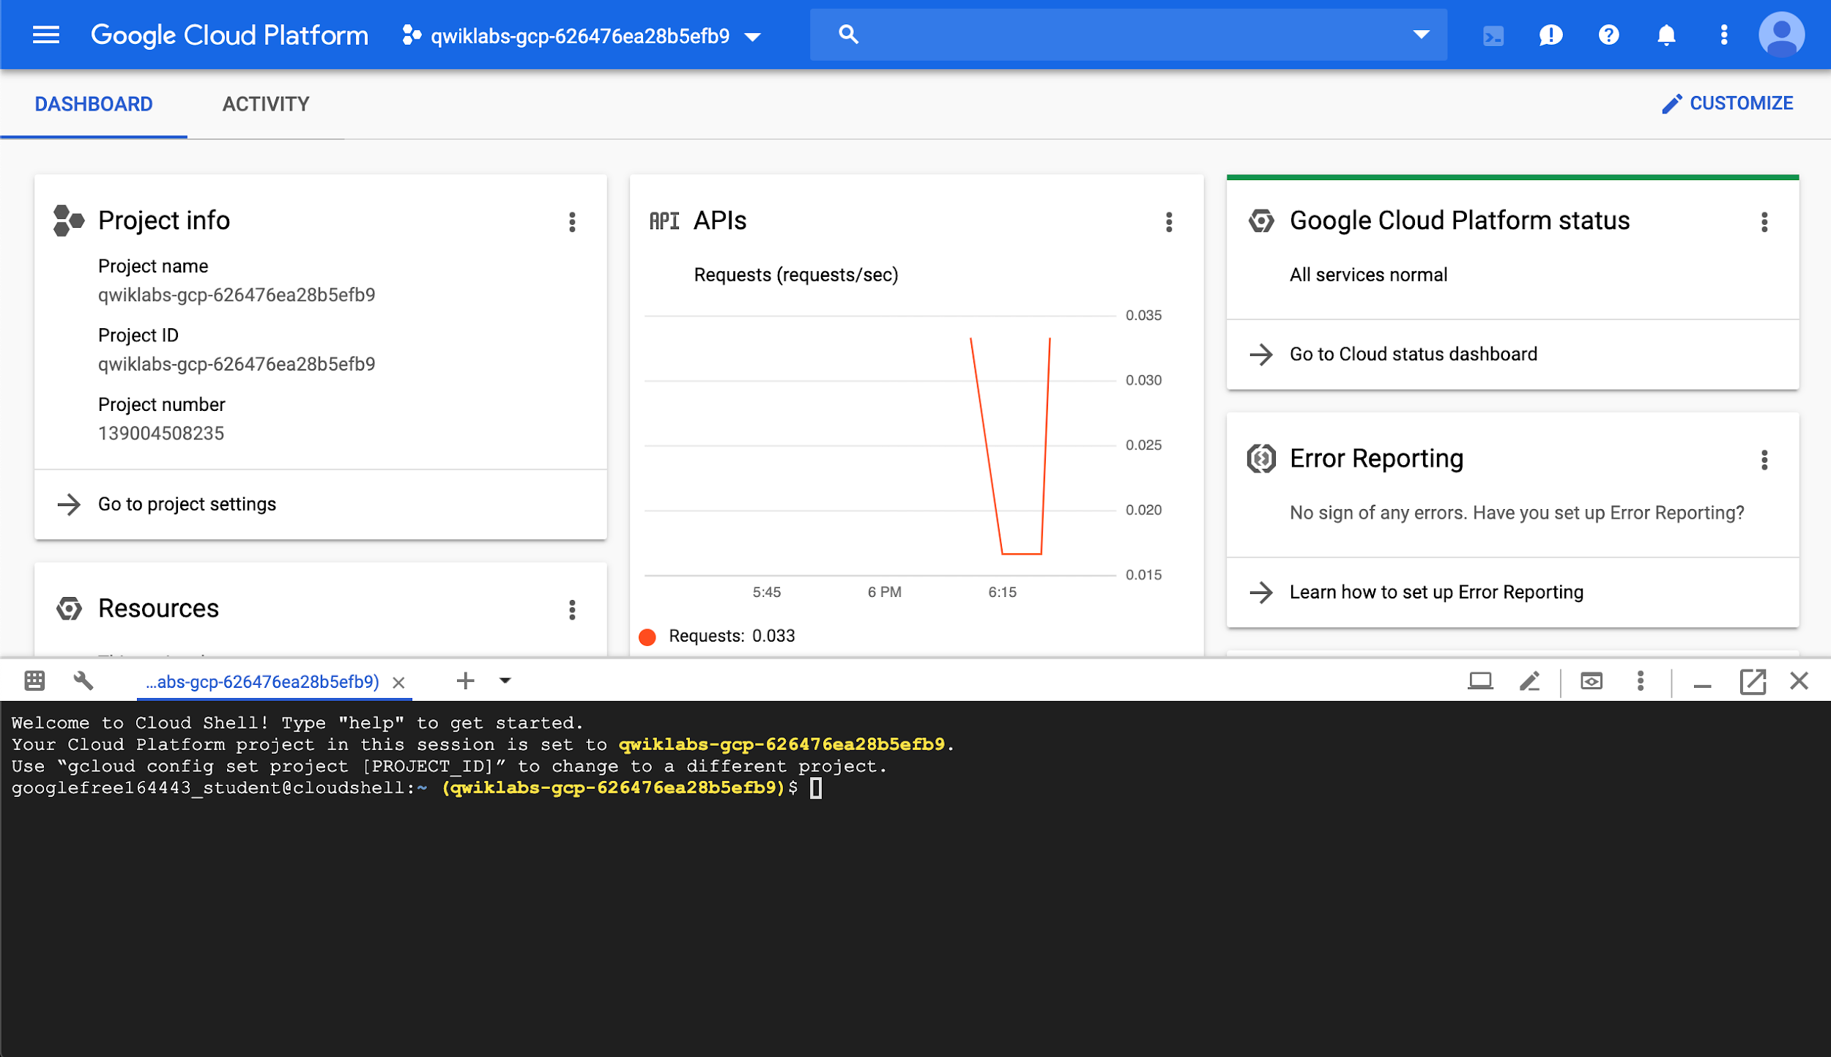
Cloud Shell
Cloud Shell is an in-browser command prompt execution environment that allows you to enter commands at a terminal prompt to manage resources and services in your GCP project.

Slide 27

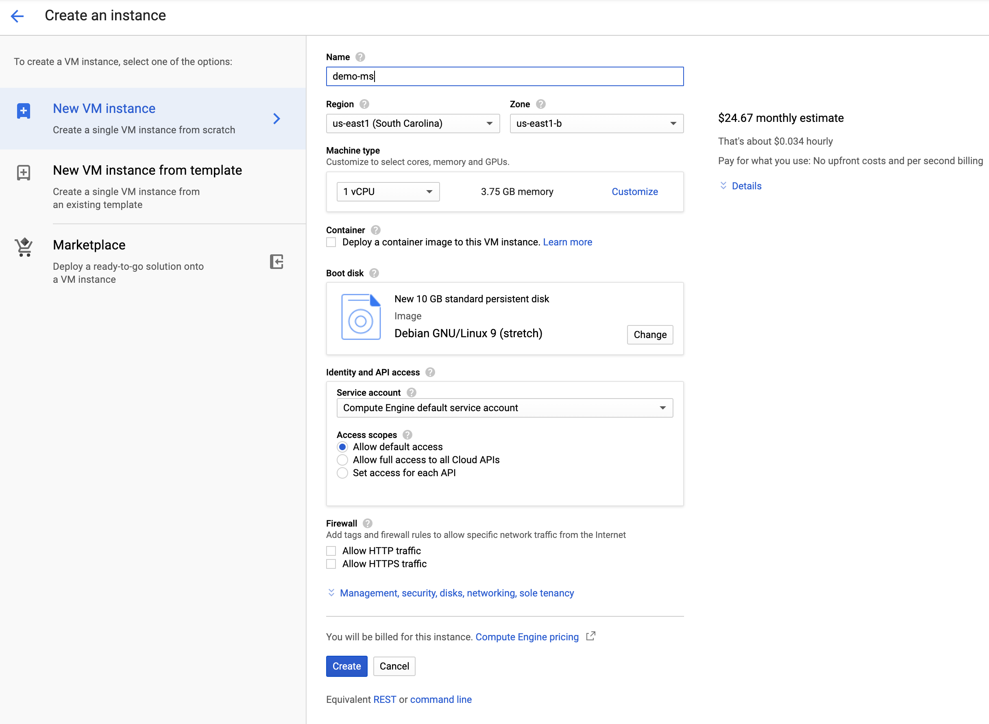
Start a Compute Engine
Go to COMPUTE > Compute Engine > Create a new instance
Provide a name
Select a micro instance!
Leave the rest of the defaults unchanged
Notice the estimated monthly charge on the top
You will be charged based on the seconds
the service was used

Slide 28
Activity - Hortonworks on Google Cloud
Complete instructions on how to deploy a Hortonworks sandbox environment on Google Cloud can be found on the document at: https://github.com/soltaniehha/Big-Data-Analytics-for-Business/blob/master/01-Introduction/Deploy-Hortonworks-Sandbox-on-Google-Cloud.pdf
Please make sure to stop or shutdown the instance when you are not using it. The allocated cost for this section should not exceed $5.

Slide 29
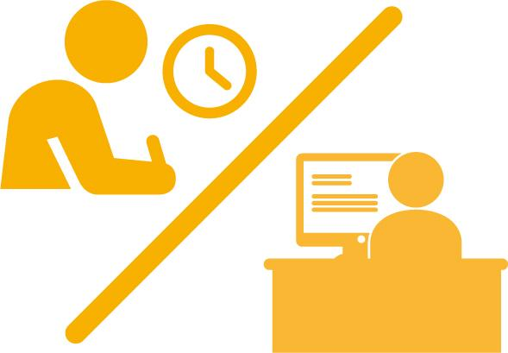
Activity
DataCamp assignments according to the syllabus
Finish setting up your Hortonworks instance on GCP
You may use this video as a guide (please note it was recorded last year and some of the steps were updated on the document)
Make sure you are on IS843 Slack

Slide 30
Remember to Stop Your VMs!

